Slide 1
Transaction Processing

Slide 2

Basic Concept of Transaction
Suppose we have to calculate total marks of a student.
The following are the steps:

Slide 3
Transaction Introduction
A set of operations that form a single logical unit of work is called a transaction.
A transaction is a program execution unit that accesses and possibly updates various data items.
E.g. Transaction to transfer $50 from account A to account B:
    1. read(A)
    2. A := A – 50
    3. write(A)
    4. read(B)
    5. B := B + 50
    6. write(B)

Slide 4
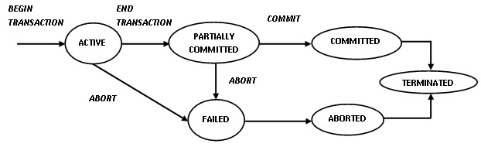
TRANSACTION STATES

Slide 5
TRANSACTION STATES
Active – the initial state; the transaction stays in this state while it is executing
Partially committed – after the final statement has been executed.
Failed – after the discovery that normal execution can no longer proceed.

Slide 6
TRANSACTION STATES
Aborted – after the transaction has been rolled back and the database restored to its state prior to the start of the transaction.
Two options after it has been aborted:
    restart the transaction
      hardware or software error
    kill the transaction
      Internal logical error
Committed – after successful completion. Once a transaction has committed, we cannot undo its effects by aborting it.

Slide 7
Transaction Properties (ACID)
A transaction has following properties:
Atomicity
Consistency
Isolation
Durability

Slide 8
ATOMICITY
  If the transaction fails after step 3 and before step 6, money will be “lost” leading to an inconsistent database state
    Failure could be due to software or hardware
  The system should ensure that updates of a partially executed transaction are not reflected in the database
  All or nothing, regarding the execution of the transaction

Slide 9
CONSISTENCY
The sum of A and B is unchanged by the execution of the transaction.
  Execution of a (single) transaction preserves the consistency of the database.
  A transaction must see a consistent database and must leave a consistent database
  During transaction execution the database may be temporarily inconsistent.
    Constraints to be verified only at the end of the transaction

Slide 10
ISOLATION
Concurrent execution of two or more transactions should be consistent is called as Isolation.
If between steps 3 and 6, another transaction T2 is allowed to access the partially updated database, it will see an inconsistent database (the sum A + B will be less than it should be).
T1 T2
  1. read(A)
  2. A := A – 50
  3. write(A)
  read(A), read(B), print(A+B)
  4. read(B)
  5. B := B + 50
  6. write(B)

Slide 11
DURABILITY
After a transaction completes successfully, the changes it has made to the database persist, even if there are system failures.
Database should be recoverable under any type of crash.

Slide 12
Example of Fund Transfer
Transaction to transfer $50 from account A to account B:
  1. read(A)
  2. A := A – 50
  3. write(A)
  4. read(B)
  5. B := B + 50
  6. write(B)

Slide 13
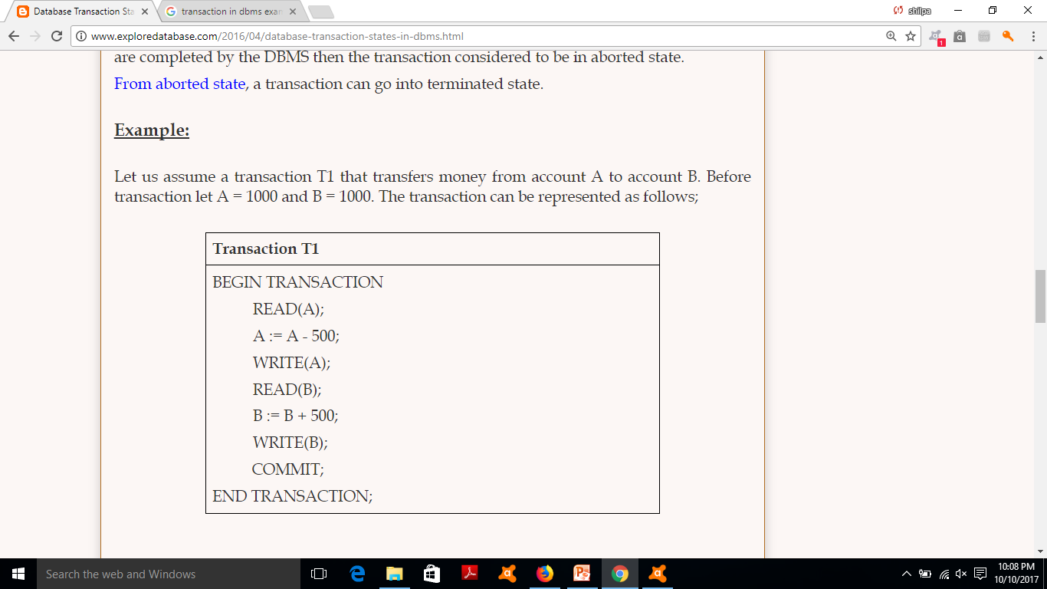
Example

Slide 14
CONCURRENT EXECUTION
Transaction processing systems usually allow multiple transactions to run parallelly.
Allowing multiple transactions to update the data concurrently causes several complications with the consistency of data.
For that, we can think that the best way of executing the transactions can be---serial execution
However, executing the multiple transactions at same time has its own benefits

Slide 15
ADVANTAGES OF CONCURRENT EXECUTION
Improved throughput and resource utilization :
  Throughput: Number of transactions executed in given amount of time.
  I/O activity and CPU activity
    One transaction can perform I/O, other can use CPU cycles for execution
Reduced Waiting time:
  In serial scheduling, a short transaction may have to wait for a preceding long transaction to complete
  Waiting time: the time for a transaction to be completed after it has been submitted for execution.

Slide 16
SCHEDULE
The execution sequence of transactions. The time order sequence of two or more transactions
Represent the chronological order in which transactions are executed in the system.
For example, Read (A) must appear before Write (A) in any transaction

Slide 17
T1 | T2
Read A | Read B
Write A | Write B
Read B | Read A
Write B | Write A
Schedule 1
T1 | T2
 | Read B
 | Write B
 | Read A
 | Write A
Read A
Write A
Read B
Write B
Schedule 2
Read A
Write A
 | Read B
 | Write B
Read B
Write B
 | Read A
 | Read A

Slide 18
TYPES OF SCHEDULES
Two types of schedules are there
  Serial
  Parallel (Concurrent)

Slide 19
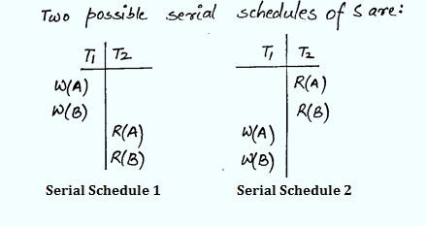
SERIAL SCHEDULE
After the commit of first transaction second transaction begins.
There is NO inconsistency in serial schedules.
It has poor throughput
It has poor resource utilization.
Eg: T1 has W(A) W(B) operations and T2 has R(A)R(B)

Slide 20

EXAMPLE SCHEDULE 1
Let T₁ transfer $50 from A ($500) to B($200), and T₂ transfer 10% of the balance from A to B.
SERIAL

Slide 21

EXAMPLE SCHEDULE 2
A serial schedule where T2 is followed by T1.
SERIAL

Slide 22
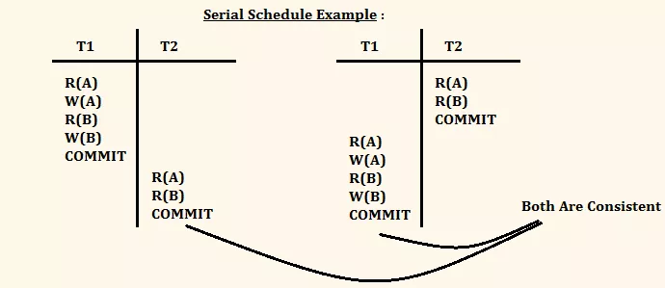
Example

Slide 23
There are two transactions T1 followed by T2 which is shown as:
T1 | T2
A=A+100
B=B-100
 | A=A*7.06
 | B=B*7.06
T1 | T2
 | A=A*7.06
 | B=B*7.06
A=A+100
B=B-100

Slide 24

PARALLEL/CONCURRENT SCHEDULE
A=1000, B= 2000
A=1000
A=950
A=950
A=950
A=95
CONSISTENT
A=855
A=855
B=2000
B=2050
B=2050
B=2050
Final sum is:
855 + 2145 = 3000
B=2145
B=2145

Slide 25

A=1000
A=950
A=1000
A=100
A=900
A=900
INCONSISTENT
B=2000
A=950
B=2000
Final sum is:
950 + 2100 = 3050
B=2050
B=2050
B=2100
B=2100

Slide 26
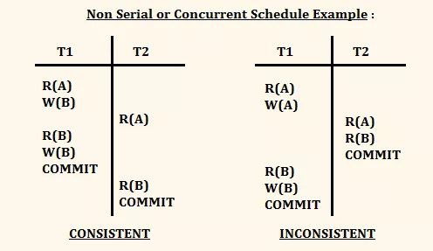
Example

Slide 27
Conflict of operations
Some times the order of read/write operations in a schedule can be changed depending upon the data. But some times cannot be changed.
Those read/write operations whose order cannot be changed without affecting the consistency called conflict operations.
Two operations are said to conflict if they are part of different transactions working on the same data item, and one must be a write operation.

Slide 29
Types
When concurrent transactions are executed in an uncontrolled manner then many problems can occur.
The following are conflict operations:
Lost Update(Write-Write conflict)
Dirty Read(Write-Read conflict)
Unrepeatable reads (Read-Write conflict)

Slide 30
Two operations (Read and Write) are consider as conflicting operations, if they hold the following conditions.
Both the operations are on the same data.
Both the operations (Read and Write) belong to different transactions.
At least one of the two operations is a write operation.
Two operations (Read and Write) are consider as Non-Conflicting Operations, if they hold the following conditions.
Both the operations are on different data item.
Both the operations belong to different transactions.

Slide 31
Lost Update Problem(write-Write)
T1 | T2
Read A
Write A
 | Write A
 | Commit
Commit

Slide 32
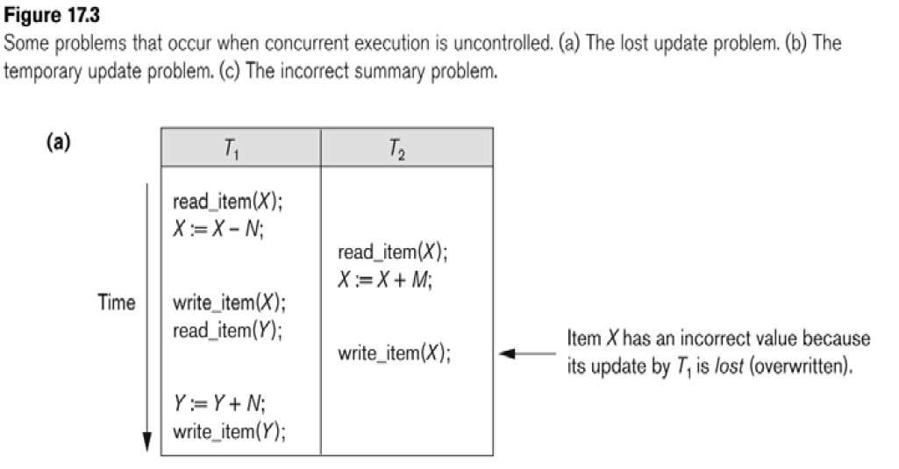

Slide 33
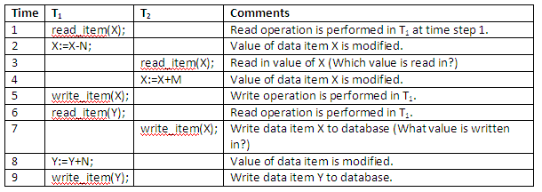
X=80 and Y=90

Slide 34
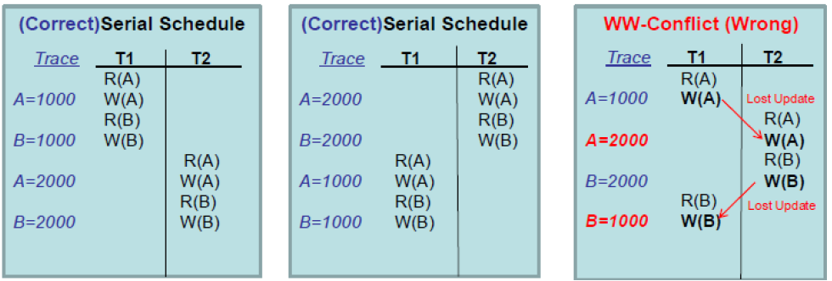

Slide 35
Method for preventing lost updates is to use optimistic concurrency control to perform what is called optimistic locking on the data. Optimistic concurrency control typically uses four phases in order to help to ensure that data isn’t lost:
Begin
Modify
Validate
Commit or Rollback

Slide 36
Dirty Read(Reading Uncommited Data)
WR Conflict
T1 reads non updates data after failure
T1 | T2
Read A
Write A
 | Read A
 | Write A
 | Commit
Failure

Slide 37
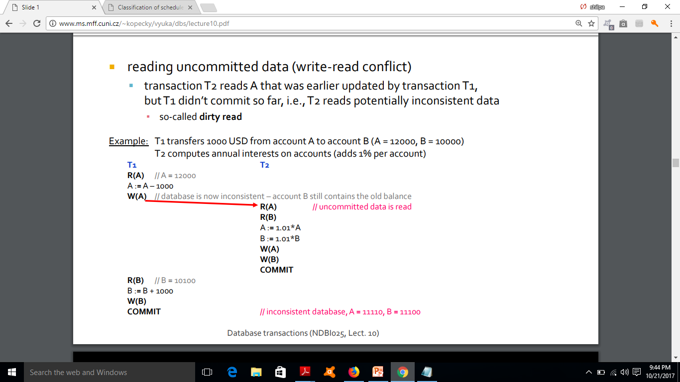

Slide 38
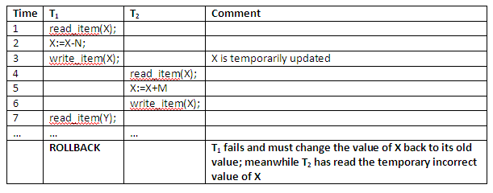

Slide 39
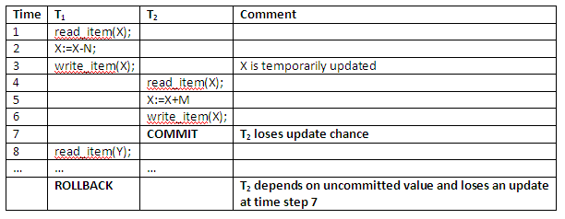

Slide 40
Unrepeatable Reads
T1 | T2
Read X
 | Read X
Write X
 | Read X

Slide 41
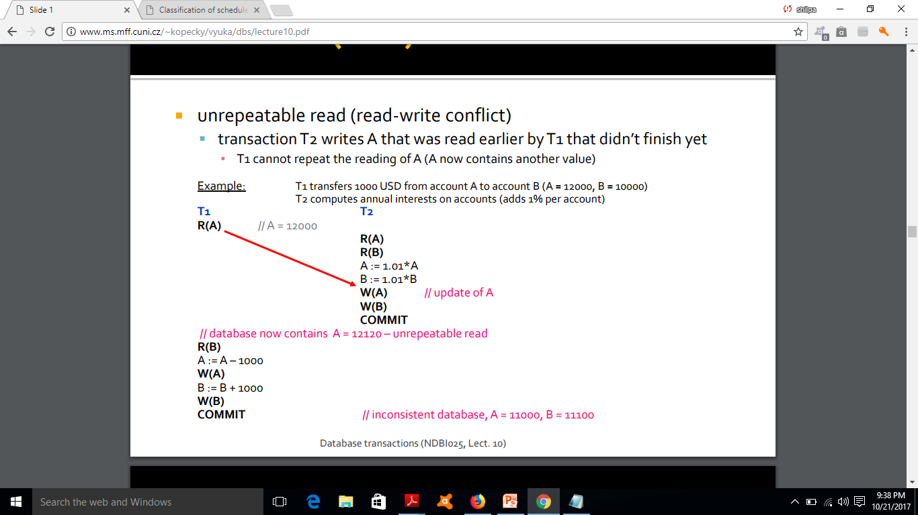

Slide 42
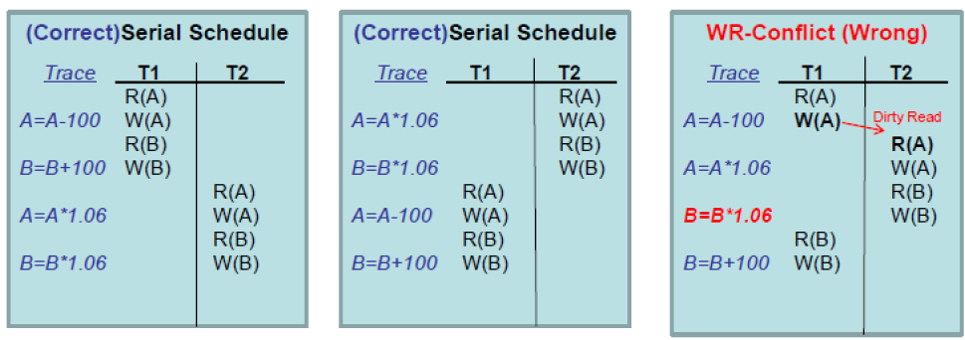

Slide 43
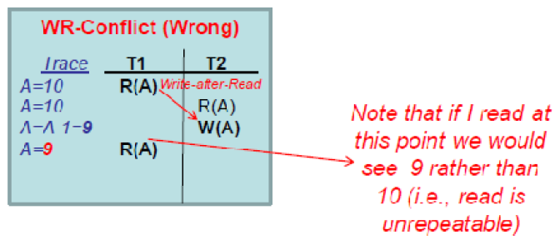

Slide 44
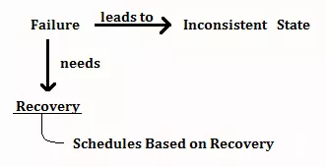
Scheduling Failure

Slide 45
CLASSIFICATION OF SCHEDULES
There are two types of classifications:
  Based of Recoverability
    Irrecoverable Schedule
    Recoverable Schedule
      Cascading Rollback
      Cascadeless Rollback
      Strict Schedule : More restrictive than Cascadeless
  Based on serializability
    Conflict Serializable Schedule
    Conflict Equivalent Schedule
    View Serializable Schedule

Slide 46
Rollback is not possible in the following cases
If transaction is committed.
If the disc crashes. Therefore the log file get lost.

Slide 47
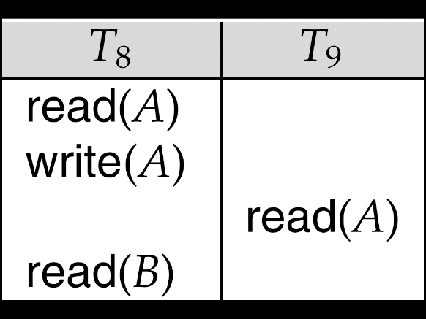
IRRECOVERABLE SCHEDULES
Irrecoverable schedule — if a transaction T_{j} reads a data item previously written by a transaction T_{i} , then the commit operation of T_{j} must appear before the commit operation of T_{i}.
The following schedule is not recoverable if T₉ commits immediately after the read
If T₈ should abort, T₉ would have read (and possibly shown to the user) an inconsistent database state. Hence, database must ensure that schedules are recoverable.
Commit
Commit

Slide 48
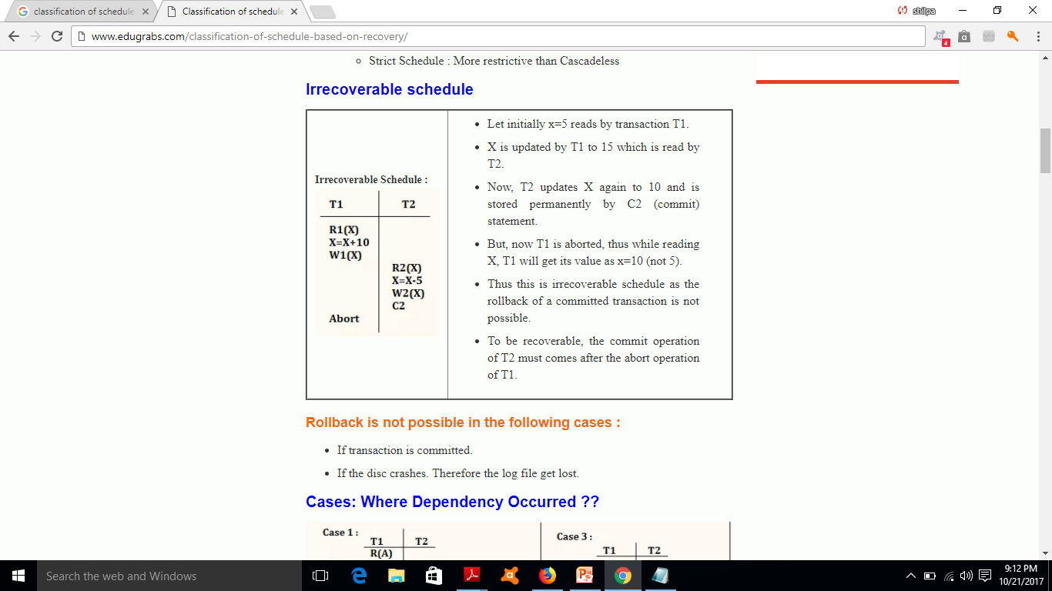
Example

Slide 49
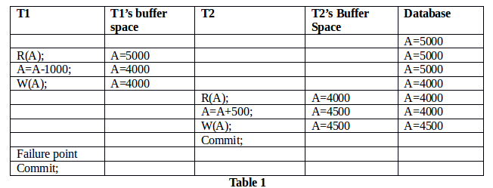

Slide 50
RECOVERABLE SCHEDULES
Recoverable schedule — if a transaction T_{j} reads a data item previously written by a transaction T_{i} , then the commit operation of T_{i} must appear before the commit operation of T_{j}.
The following schedule is recoverable if T₉ commits after the T₈
Commit
Commit

Slide 51
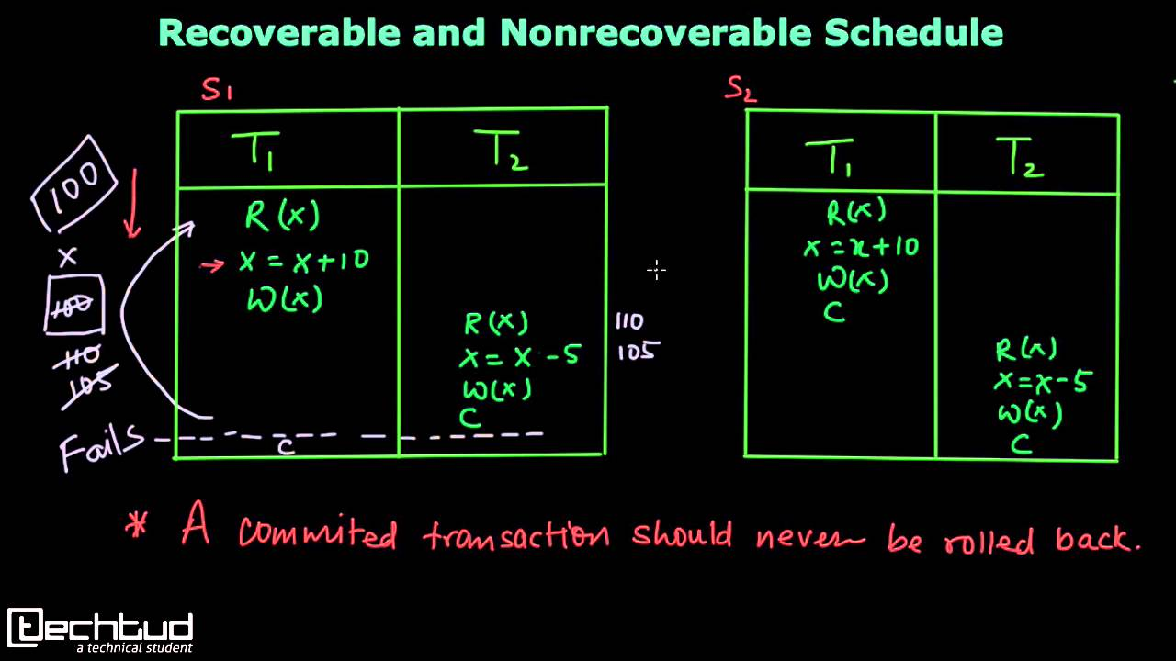

Slide 52

CASCADING ROLLBACKS
Cascading rollback – a single transaction failure leads to a series of transaction rollbacks. Consider the following schedule where none of the transactions has yet committed (so the schedule is recoverable)
If T₁₀ fails, T₁₁ and T₁₂ must also be rolled back.
Can lead to the undoing of a significant amount of work

Slide 53
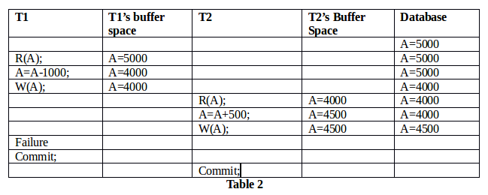

Slide 54
CASCADELESS SCHEDULES
Cascadeless schedules — in these, cascading rollbacks cannot occur; for each pair of transactions T_{i} and T_{j} such that T_{j} reads a data item previously written by T_{i}, the commit operation of T_{i} appears before the read operation of T_{j}.
Every cascadeless schedule is also recoverable
It is desirable to restrict the schedules to those that are cascadeless.

Slide 55
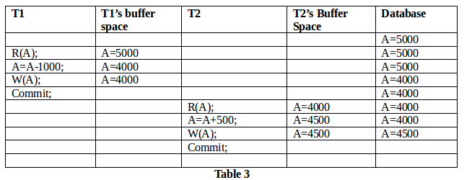

Slide 56
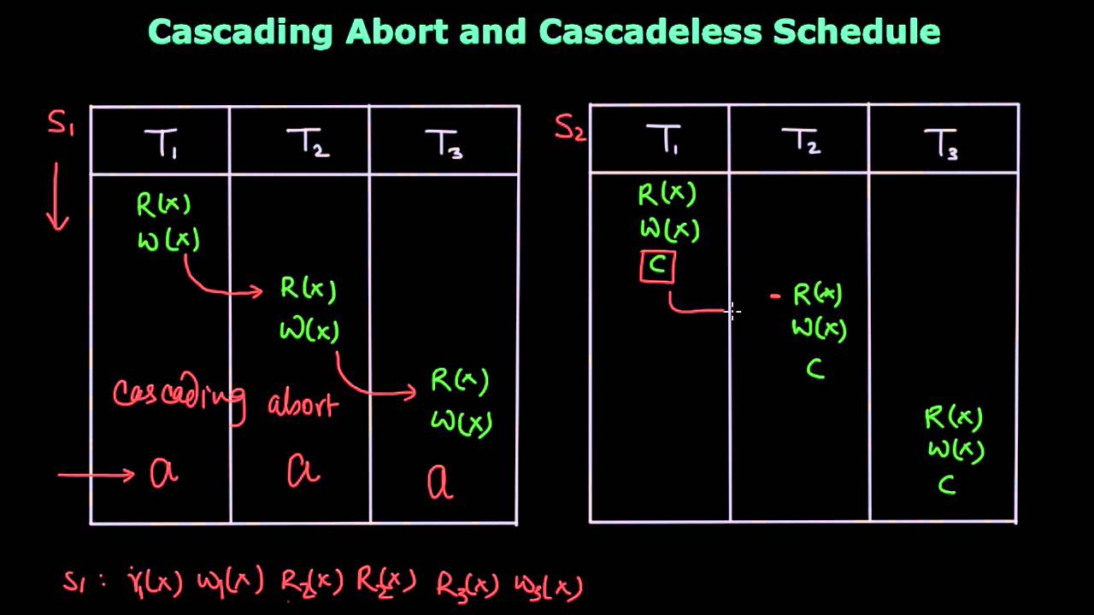

Slide 57
SERIALIZABILITY
To ensure consistency of the database under concurrent execution.
All serial schedules are serializable schedules.
That is, the schedule should, in some sense, be equivalent to a serial schedule. Such schedules are called serializable schedules.
A schedule s of ‘n’ transaction is serializable if it is equivalent to some other schedule s’ of same ‘n’ transaction.

Slide 58
SERIALIZABILITY

Slide 59
How we can check the equivalent
Conflict equivalence serializable
View Equivalence serializable

Slide 60
SERIALIZABILITY
For serializability, we need to consider only two operations: READ and WRITE.
Two types of serializability is there :
  Conflict serializability
  View serializability

Slide 61
CONFLICTING INSTRUCTIONS
Consider a schedule S in which two consecutive instructions I_{i} and I_{j} of transactions T_{i} and T_{j.}
If I_{i} and I_{j} of transactions T_{i} and T_{j} refer to different data items, then we can swap I_{i} and I_{j} without affecting the results.
Instructions I_{i} and I_{j} of transactions T_{i} and T_{j} respectively, conflict if and only if both I_{i} and I_{j} access same data item Q, and at least one of them is write(Q).
1. I_{i} = read(Q), I_{j} = read(Q): No conflict.
2. I_{i} = read(Q), I_{j} = write(Q): Conflict.
3. I_{i} = write(Q), I_{j} = read(Q): Conflict
4. I_{i} = write(Q), I_{j} = write(Q): Conflict

Slide 62
CONFLICT SERIALIZABILITY
Conflict equivalent : If a schedule S can be transformed to S1 by swapping of non conflicting instructions of different transactions.
Conflict serializable : Schedule S is conflict serializable if it is conflict equivalent to a serial schedule.

Slide 63


CONFLICT SERIALIZABILITY
Schedule 3 can be transformed into Schedule 6, a serial schedule where T2 follows T1, by series of swaps of non-conflicting instructions. Therefore it is conflict serializable.
Schedule 3
Schedule 6

Slide 64
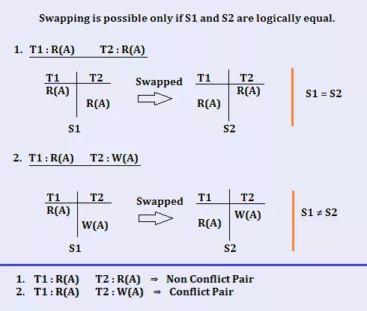

Slide 65

CONFLICT SERIALIZABILITY
Example of a schedule that is not conflict serializable:
We are unable to swap instructions in the above schedule to obtain either the serial schedule < T₃, T₄ >, or the serial schedule < T₄, T₃ >.

Slide 66
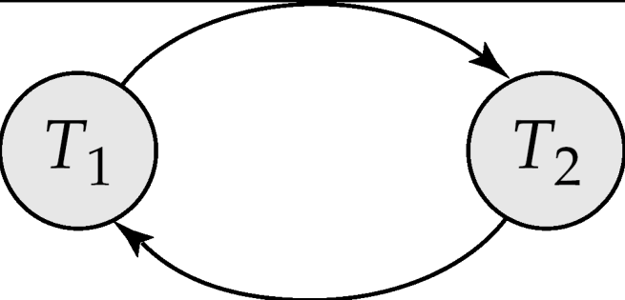
TESTING FOR SERIALIZABILITY
Consider some schedule of a set of transactions T₁, T₂, ..., T_{n}
Precedence graph — a directed graph where
  The vertices are the transactions (names of the transactions).
  There is an arc from T_{i} to T_{j} if the two transaction conflicts.
We may label the arc by the item that was accessed.
Example 1
x
y

Slide 67
Steps for Graph
Create nodes for each Transaction.
Ti→Tj, if Tj read the value of item after written by Ti.
Ti→Tj,if Tj writes the value of data item after read by Ti
T1→ Tj If Tj Writes after Ti.
A schedule is Conflict serializable if it is Acyclic.

Slide 68
EXAMPLE SCHEDULE A + PRECEDENCE GRAPH
T1 T2 T3 T4 T5
read(X)
read(Y)
read(Z)
read(V)
read(W)
read(W)
read(Y)
write(Y)
write(Z)
read(U)
read(Y)
write(Y)
read(Z)
write(Z)
read(U)
write(U)
T₁
T₂
T₄
T₃
T₅

Slide 69
TEST FOR CONFLICT SERIALIZABILITY
A schedule is conflict serializable if and only if its precedence graph is acyclic.
If precedence graph is acyclic, the serializability order can be obtained by a topological sorting of the graph.
  This is a linear order consistent with the partial order of the graph.
  For example, a serializability order for Schedule A would be
  T₅ → T₁ → T₃ → T₂ → T₄

Slide 70
Example
T1 | T2 | T3
Read X
 | Read Z
Read Z
 |  | Read X
 |  | Read Y
 |  | Write X
 | Read Y
 | Write Z
 | Write Y

Slide 71
Z
X y
Acyclic Graph
T1
T2
T3

Slide 72
Practice
T1 | T2 | T3
Read X
 |  | Read X
 |  | Write X
Write X
 | Read X

Slide 73
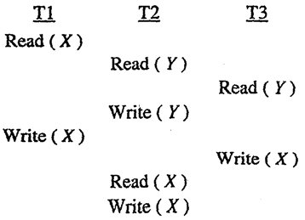
Practice 2

Slide 74
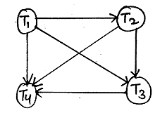
EXAMPLE(Acyclic graph)
  T₁ → T₂ → T₃ → T₄

Slide 75
VIEW SERIALIZABILITY
Sometimes it is possible to serialize schedules that are not conflict serializable.
View serializability provides a weaker and still consistency preserving notion of serialization.
Let S and S´ be two schedules with the same set of transactions. S and S´ are view equivalent if the following three conditions are met, for each data item Q,

Slide 76
VIEW SERIALIZABILITY
  If in schedule S, transaction T_{i} reads the initial value of Q, then in schedule S’ also transaction T_{i} must read the initial value of Q.
  If in schedule S transaction T_{i} executes read(Q), and that value was produced by transaction T_{j} (if any), then in schedule S’ also transaction T_{i} must read the value of Q that was produced by the same write(Q) operation of transaction T_{j} .
  The transaction (if any) that performs the final write(Q) operation in schedule S must also perform the final write(Q) operation in schedule S’.

Slide 77
VIEW SERIALIZABILITY
A schedule S is view serializable if it is view equivalent to a serial schedule.
Every conflict serializable schedule is also view serializable.
Below is a schedule which is view-serializable but not conflict serializable.
It is equivalent to either <T3,T4,T6> or <T4,T3,T6>
Every view serializable schedule that is not conflict serializable has blind writes.

Slide 78
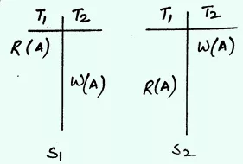
View Equivalent Schedule
Consider two schedules S1 and S2, they are said to be view equivalent if following conditions are true :
S1 : T1 reads A from Database.
S2 : T1 reads A from T2.
∴ S1 ≠ S2.

Slide 79
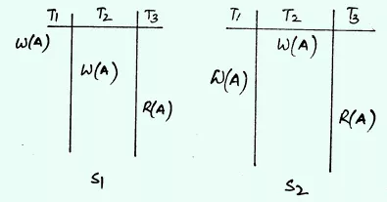
S1 : T3 reads value of A from T2.
S2 : T3 reads value of A from T1.
∴ S1 ≠ S2.
i.e. write-read sequence is not same between S1 and S2.

Slide 80


Slide 81
Example
T1 | T2
Read A
Write A
 | Read A
 | Write A
Read B
Write B
 | Read B
 | Write B
T1 | T2
Read A
Write A
Read B
Write B
 | Read A
 | Write A
 | Read B
 | Write B

Slide 82
Check whether the schedules is conflict serializable or not S : R2(A); W2(A); R3(C); W2(B); W3(A); W3(C); R1(A); R1(B); W1(A); W1(B)

Slide 83
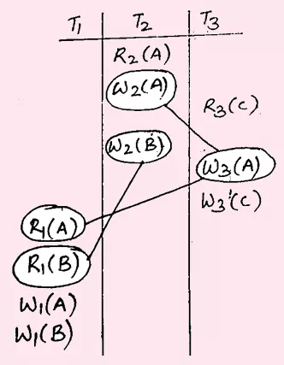

Slide 84
Conflict Pairs Dependency Relation
W2(A) W3(A) T2 → T3
W3(A) R1(A) T3 → T1
W2(B) R1(B) T2 → T1

